Slide 1
SľOCK PRICE PREDICľION

Slide 2
DONE BY:-
Pratyusha Mandal(RA2011042010085)
Dhruv Goyal(RA2011042010089)
Raksha Thakur(RA2011042010112)

Slide 3
CONľENľ
Machine Learning
Deep Learning
Deep Learning Necessity
Google Stock Price Dataset
Algorithm
Conclusion
References

Slide 4
ABSTRACT
Demand of Stock have become huge with Increased in popularity of Stock in Digital world. Prediction and Analysing stock can benefit People to think before buying or selling stocks. So, A New Stock Price Prediction through Deep Learning Algorithms has been analyzed and visualized. through this System we can predict of any Company stock in the world.

Slide 5
MACHINE LEARNING
Machine learning is the science of getting computers to act without being explicitly programmed.
Machine learning is a method of data analysis that automates analytical model building
Machine learning is important because it gives enterprises a view of trends in customer behavior and business operational patterns, as well as supports the development of new products

Slide 6
DEEP LEARNING
Deep learning is an artificial intelligence (AI) function that imitates the workings of the human brain in processing data and creating patterns for use in decision making.
Deep learning is a subset of machine learning in artificial intelligence that has networks capable of learning unsupervised from data that is unstructured or unlabeled. Also known as deep neural learning or deep neural network.
Deep learning attempts to mimic the human brain—albeit far from matching its ability—enabling systems to cluster data and make predictions with incredible accuracy.

Slide 7
DEEP LEARNING NECESSIľY
Deep learning has evolved hand-in-hand with the digital era, which has brought about an explosion of data in all forms and from every region of the world. This data, known simply as big data, is drawn from sources like social media, internet search engines, e-commerce platforms, and online cinemas, among others.
This enormous amount of data is readily accessible and can be shared through fintech applications like cloud computing.
However, the data, which normally is unstructured, is so vast that it could take decades for humans to comprehend it and extract relevant information. Companies realize the incredible potential that can result from unraveling this wealth of information and are increasingly adapting to AI systems for automated support.

Slide 8
GOOGLE SľOCK PRICE DAľASEľ
Google LLC is an American multinational technology company that specializes in Internet-related services and products, which include online advertising technologies, a search engine, cloud computing, software, and hardware.
It is considered one of the big four Internet stocks along with Amazon, Facebook, and Apple The company is listed on the NASDAQ stock exchange under the ticker symbol GOOG. We have Included 5 year Stock Price of Google for this Project.

Slide 9
ALGORIľHM
SEQUENľIAL
DENSE
LSľM
DROPOUľ

Slide 10
CONCLUSION
We can see the Prediction, analysis and Visualization of Google stock Price hough applying Deep learning algorithms such as LSľM, DENSE, DROP OUľ and SEQUENľIAL.
Same way we can use any company Stock Dataset directly apply this algorithms it will give us the correct prediction.
ľhis System is Successfully runs on any system even on Cloud platforms.

Slide 11

REFRENCES
https://machinelearningmastery.com/start-here/ getstarted
https://colah.github.io/posts/2015-08-Understanding-LSľMs/
https://www.sas.com/en_us/insights/analytics/machine-learning.html
https://groww.in/us-stocks/googl
https://www.investopedia.com/terms/d/deep-learning.asp
https://www.nasdaq.com/market-activity/stocks/goog

Slide 12
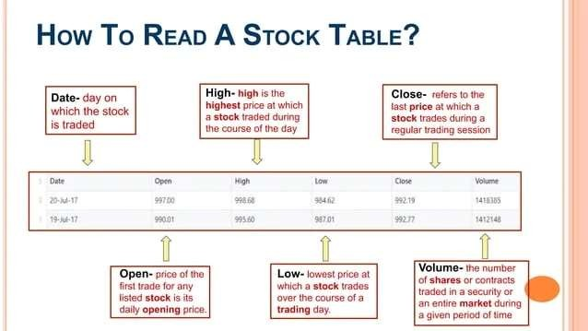

Slide 13
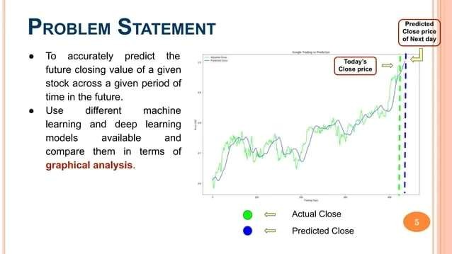

Slide 14
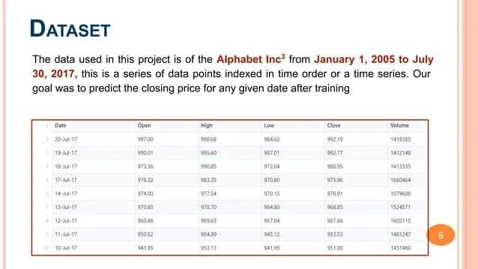

Slide 15
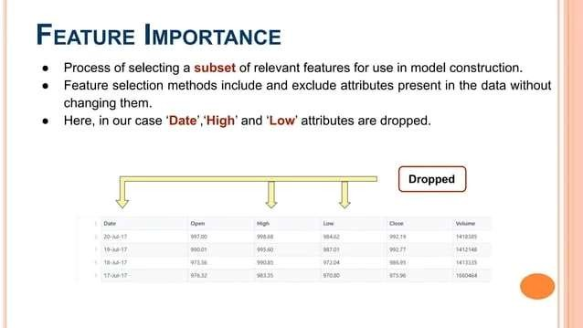

Slide 16
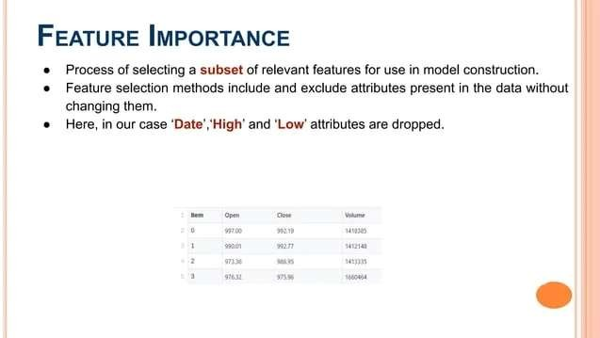

Slide 17
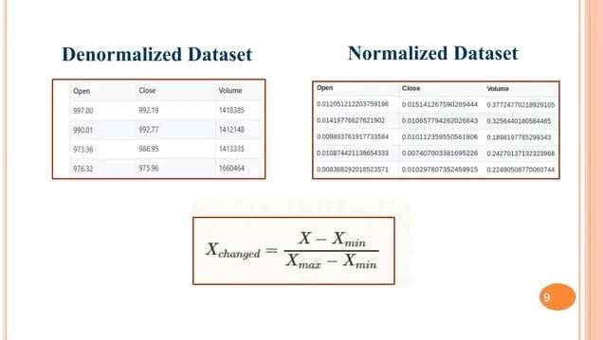

Slide 18
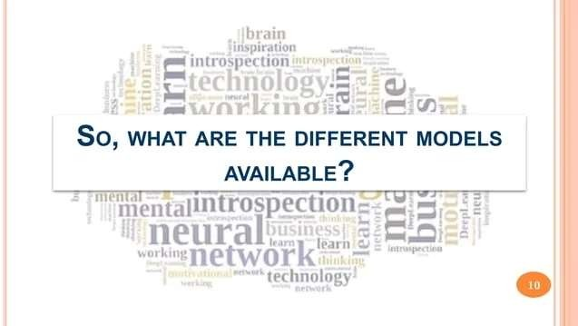

Slide 19
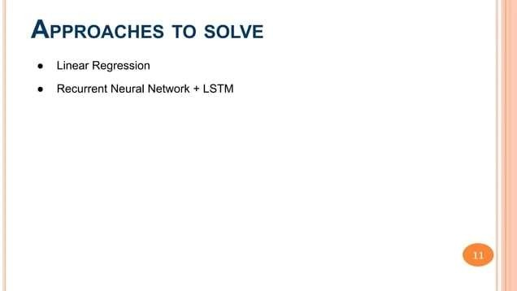

Slide 20
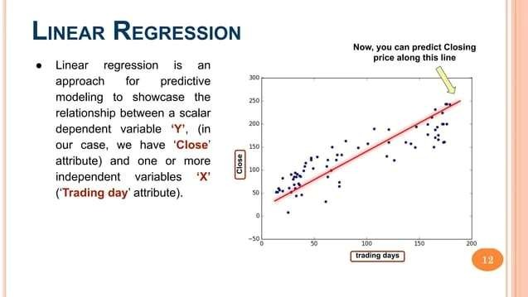

Slide 21
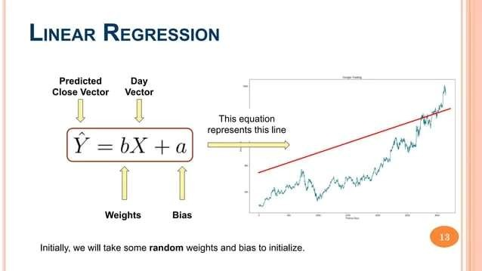

Slide 22
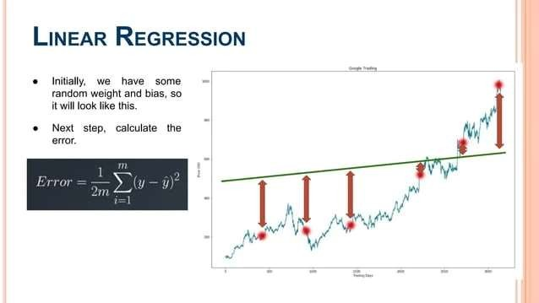

Slide 23
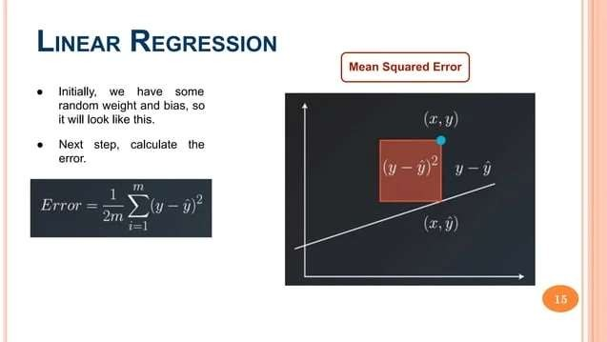

Slide 24
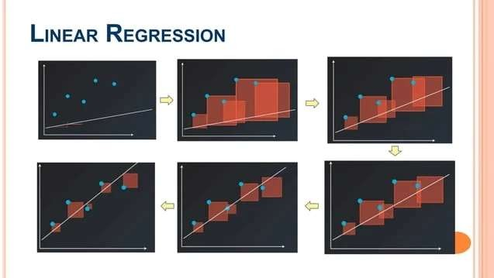

Slide 25
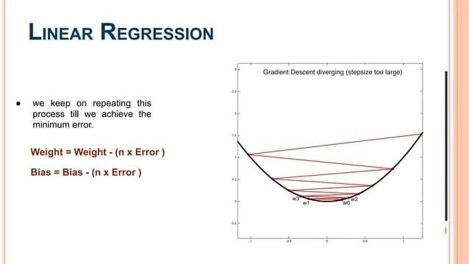

Slide 26
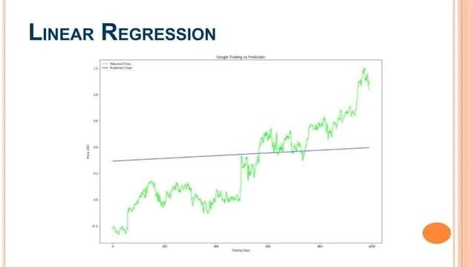

Slide 27
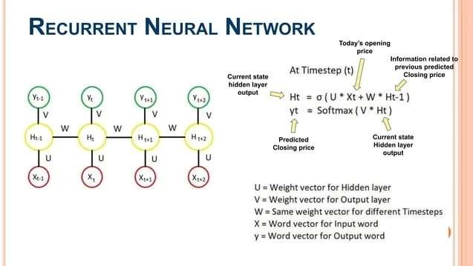

Slide 28
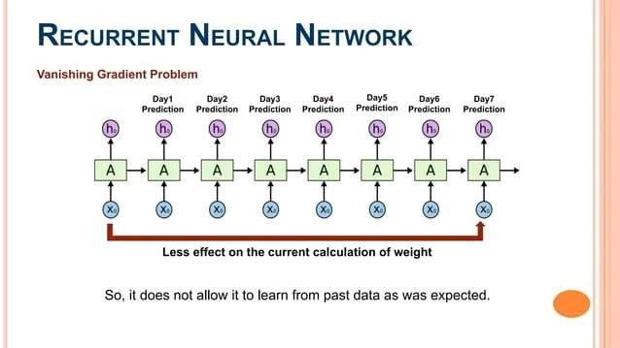

Slide 29
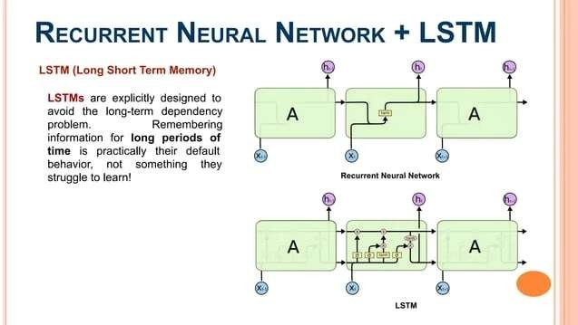

Slide 30
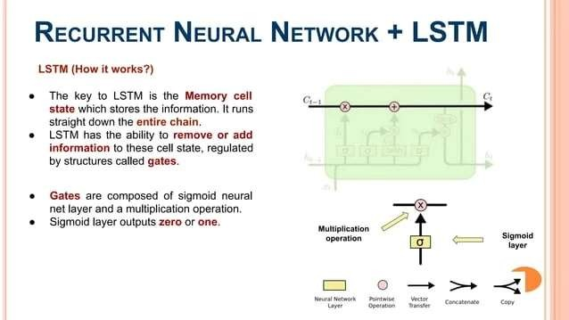

Slide 31
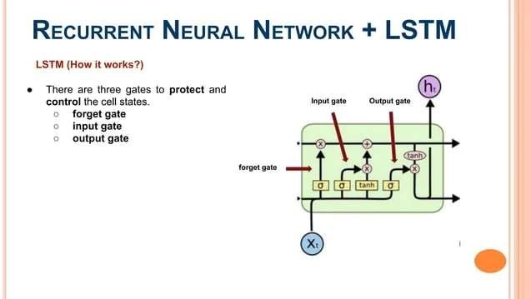

Slide 32
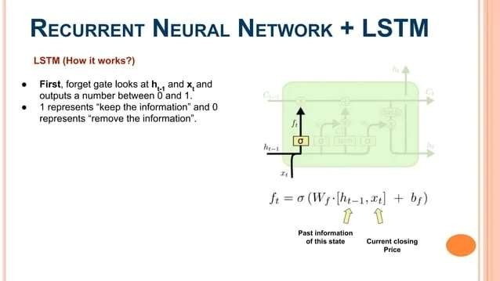

Slide 33
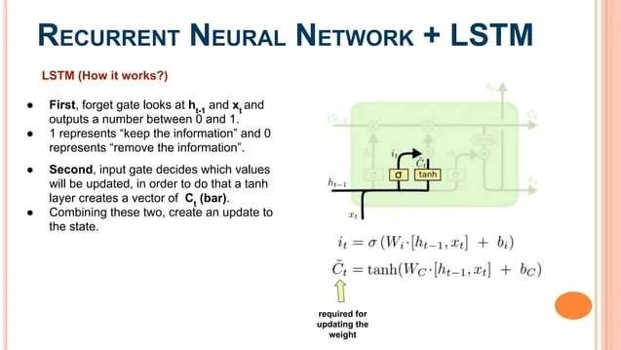

Slide 34
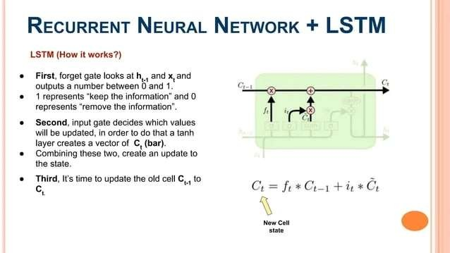

Slide 35
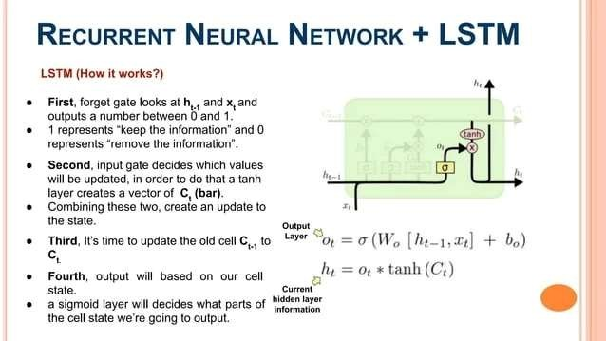

Slide 36
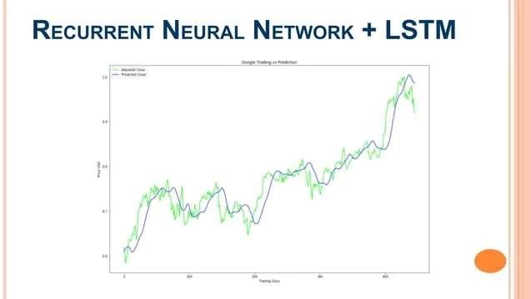

Slide 37
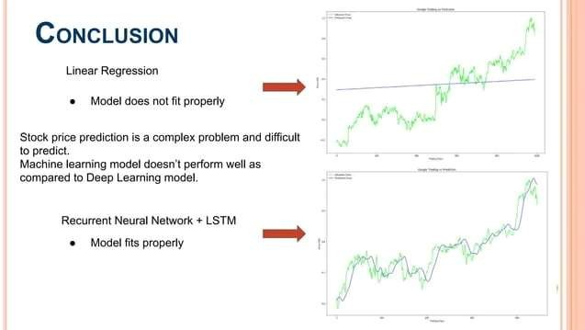

Slide 38


